Slide 1
CS162 Operating Systems and Systems Programming Lecture 4 Process Management, Fork, and Introduction to I/O (Everything is a File!)
January 26th, 2023
Prof. John Kubiatowicz
http://cs162.eecs.Berkeley.edu

Slide 2
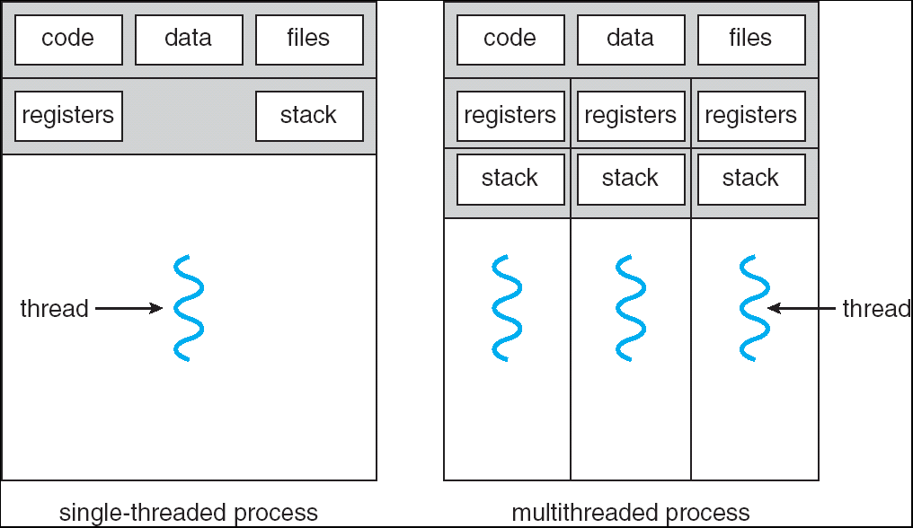
Recall: Processes
How to manage process state?
How to create a process?
How to exit from a process?
Remember: Everything outside of the kernel is running in a process!
Including the shell! (Homework 2)
Processes are created and managed… by processes!

Slide 3
Bootstrapping
If processes are created by other processes, how does the first process start?
First process is started by the kernel
Often configured as an argument to the kernel before the kernel boots
Often called the “init” process
After this, all processes on the system are created by other processes

Slide 4
Process Management API
exit – terminate a process
fork – copy the current process
exec – change the program being run by the current process
wait – wait for a process to finish
kill – send a signal (interrupt-like notification) to another process
sigaction – set handlers for signals

Slide 5
Process Management API
exit – terminate a process
fork – copy the current process
exec – change the program being run by the current process
wait – wait for a process to finish
kill – send a signal (interrupt-like notification) to another process
sigaction – set handlers for signals

Slide 6
pid.c
#include <stdlib.h>
#include <stdio.h>
#include <string.h>
#include <unistd.h>
#include <sys/types.h>
int main(int argc, char *argv[])
{
/* get current processes PID */
pid_t pid = getpid();
printf("My pid: %d\n", pid);
exit(0);
}
Q: What if we let main return without ever calling exit?
The OS Library calls exit() for us!
The entrypoint of the executable is in the OS library
OS library calls main
If main returns, OS library calls exit
You’ll see this in Project 0: init.c

Slide 7
Process Management API
exit – terminate a process
fork – copy the current process
exec – change the program being run by the current process
wait – wait for a process to finish
kill – send a signal (interrupt-like notification) to another process
sigaction – set handlers for signals

Slide 8
Creating Processes
pid_t fork() – copy the current process
New process has different pid
New process contains a single thread
Return value from fork(): pid (like an integer)
When > 0:
Running in (original) Parent process
return value is pid of new child
When = 0:
Running in new Child process
When < 0:
Error! Must handle somehow
Running in original process
State of original process duplicated in both Parent and Child!
Address Space (Memory), File Descriptors (covered later), etc…

Slide 9
fork1.c
#include <stdlib.h>
#include <stdio.h>
#include <unistd.h>
#include <sys/types.h>
int main(int argc, char *argv[]) {
pid_t cpid, mypid;
pid_t pid = getpid(); /* get current processes PID */
printf("Parent pid: %d\n", pid);
cpid = fork();
if (cpid > 0) { /* Parent Process */
mypid = getpid();
printf("[%d] parent of [%d]\n", mypid, cpid);
} else if (cpid == 0) { /* Child Process */
mypid = getpid();
printf("[%d] child\n", mypid);
} else {
perror("Fork failed");
}
}

Slide 10
fork1.c
#include <stdlib.h>
#include <stdio.h>
#include <unistd.h>
#include <sys/types.h>
int main(int argc, char *argv[]) {
pid_t cpid, mypid;
pid_t pid = getpid(); /* get current processes PID */
printf("Parent pid: %d\n", pid);
cpid = fork();
if (cpid > 0) { /* Parent Process */
mypid = getpid();
printf("[%d] parent of [%d]\n", mypid, cpid);
} else if (cpid == 0) { /* Child Process */
mypid = getpid();
printf("[%d] child\n", mypid);
} else {
perror("Fork failed");
}
}
c
p

Slide 11
fork1.c
#include <stdlib.h>
#include <stdio.h>
#include <unistd.h>
#include <sys/types.h>
int main(int argc, char *argv[]) {
pid_t cpid, mypid;
pid_t pid = getpid(); /* get current processes PID */
printf("Parent pid: %d\n", pid);
cpid = fork();
if (cpid > 0) { /* Parent Process */
mypid = getpid();
printf("[%d] parent of [%d]\n", mypid, cpid);
} else if (cpid == 0) { /* Child Process */
mypid = getpid();
printf("[%d] child\n", mypid);
} else {
perror("Fork failed");
}
}
p
c

Slide 12
Mystery: fork_race.c
int i;
pid_t cpid = fork();
if (cpid > 0) {
for (i = 0; i < 10; i++) {
printf("Parent: %d\n", i);
// sleep(1);
}
} else if (cpid == 0) {
for (i = 0; i > -10; i--) {
printf("Child: %d\n", i);
// sleep(1);
}
}
What does this print?
Would adding the calls to sleep() matter?
Recall: a process consists of one or more threads executing in an address space
Here, each process has a single thread
These threads execute concurrently

Slide 13
Process Management API
exit – terminate a process
fork – copy the current process
exec – change the program being run by the current process
wait – wait for a process to finish
kill – send a signal (interrupt-like notification) to another process
sigaction – set handlers for signals

Slide 14
Starting new Program: variants of exec
…
cpid = fork();
if (cpid > 0) { /* Parent Process */
tcpid = wait(&status);
} else if (cpid == 0) { /* Child Process */
char *args[] = {“ls”, “-l”, NULL};
execv(“/bin/ls”, args);
/* execv doesn’t return when it works.
So, if we got here, it failed! */
perror(“execv”);
exit(1);
}
…

Slide 15
fork2.c – parent waits for child to finish
int status;
pid_t tcpid;
…
cpid = fork();
if (cpid > 0) { /* Parent Process */
mypid = getpid();
printf("[%d] parent of [%d]\n", mypid, cpid);
tcpid = wait(&status);
printf("[%d] bye %d(%d)\n", mypid, tcpid, status);
} else if (cpid == 0) { /* Child Process */
mypid = getpid();
printf("[%d] child\n", mypid);
exit(42);
}
…

Slide 16
Process Management: The Shell pattern
child
pid=fork();
if (pid==0)
exec(…);
else
wait(&stat)
main() {
…
}
exec
fork
pid=fork();
if (pid==0)
exec(…);
else
wait(&stat)
parent
pid=fork();
if (pid==0)
exec(…);
else
wait(&stat)
fork
wait

Slide 17
Administrivia
Kubiatowicz Office Hours (Starting next week)
2pm-3pm, Monday & Wednesday
TOMORROW (Friday) is Drop Deadline! VERY HARD TO DROP LATER!
Recommendation: Read assigned readings before lecture
Starting next week, we will be adhering to strict slip-day policies for non-DSP students
Slip days are no-questions asked (or justification needed) extensions
Anything beyond this requires documentation (i.e. doctor’s note, etc)
If you run out of slip days, assignments will be discounted 10%/day
You get 4 slip days for homework and 5 slip days for group projects
No project extensions on design documents, since we need to keep design reviews on track
You should be going to sections – Important information covered in section
Any section will do until groups assigned
Get finding groups of 4 people ASAP
Priority for same section; if cannot make this work, keep same TA
Remember: Your TA needs to see you in section!
Midterm 1 will be on 2/16 from 7-9pm

Slide 18
Process Management API
exit – terminate a process
fork – copy the current process
exec – change the program being run by the current process
wait – wait for a process to finish
kill – send a signal (interrupt-like notification) to another process
sigaction – set handlers for signals

Slide 19
inf_loop.c
#include <stdlib.h>
#include <stdio.h>
#include <sys/types.h>
#include <unistd.h>
#include <signal.h>
void signal_callback_handler(int signum) {
printf(“Caught signal!\n”);
exit(1);
}
int main() {
struct sigaction sa;
sa.sa_flags = 0;
sigemptyset(&sa.sa_mask);
sa.sa_handler = signal_callback_handler;
sigaction(SIGINT, &sa, NULL);
while (1) {}
}
Q: What would happen if the process receives a SIGINT signal, but does not register a signal handler?
A: The process dies!
For each signal, there is a default handler defined by the system

Slide 20
Common POSIX Signals
SIGINT – control-C
SIGTERM – default for kill shell command
SIGSTP – control-Z (default action: stop process)
SIGKILL, SIGSTOP – terminate/stop process
Can’t be changed with sigaction
Why?

Slide 21
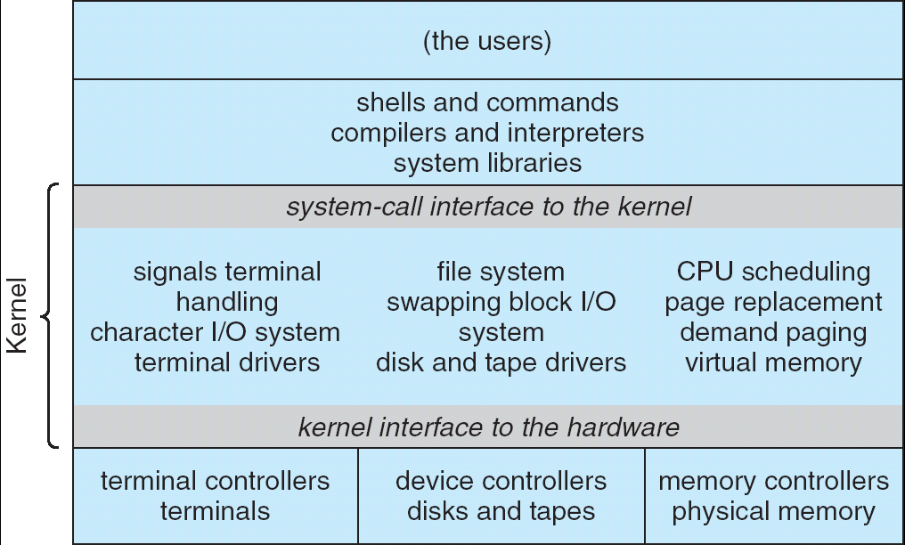
Recall: UNIX System Structure
Applications
User Mode
Standard Libs
Kernel Mode
Hardware

Slide 22
A Kind of Narrow Waist
Word Processing
Compilers
Web Browsers
Email
Databases
Web Servers
Application / Service
Portable OS Library
OS
User
System Call
Interface
System
Portable OS Kernel
Software
Platform support, Device Drivers
Hardware
x86
PowerPC
ARM
PCI
Ethernet (1Gbs/10Gbs)
802.11 a/g/n/ac
SCSI
Graphics
Thunderbolt

Slide 23
Recall: OS Library (libc) Issues Syscalls
Proc 1
Proc 2
Proc n
…
OS
Appln
login
Window Manager
…
libc
OS library
OS library
OS library
OS
OS Library: Code linked into the user-level application that provides a clean or more functional API to the user than just the raw syscalls
Most of this code runs at user level, but makes syscalls (which run at kernel level)

Slide 24
Unix/POSIX Idea: Everything is a “File”
Identical interface for:
Files on disk
Devices (terminals, printers, etc.)
Regular files on disk
Networking (sockets)
Local interprocess communication (pipes, sockets)
Based on the system calls open(), read(), write(), and close()
Additional: ioctl() for custom configuration that doesn’t quite fit
Note that the “Everything is a File” idea was a radical idea when proposed
Dennis Ritchie and Ken Thompson described this idea in their seminal paper on UNIX called “The UNIX Time-Sharing System” from 1974
I posted this on the resources page if you are curious

Slide 25
Aside: POSIX interfaces
POSIX: Portable Operating System Interface (for uniX?)
Interface for application programmers (mostly)
Defines the term “Unix,” derived from AT&T Unix
Created to bring order to many Unix-derived OSes, so applications are portable
Partially available on non-Unix OSes, like Windows
Requires standard system call interface

Slide 26
The File System Abstraction
File
Named collection of data in a file system
POSIX File data: sequence of bytes
Could be text, binary, serialized objects, …
File Metadata: information about the file
Size, Modification Time, Owner, Security info, Access control
Directory
“Folder” containing files & directories
Hierachical (graphical) naming
Path through the directory graph
Uniquely identifies a file or directory
/home/ff/cs162/public_html/fa14/index.html
Links and Volumes (later)

Slide 27
Connecting Processes, File Systems, and Users
Every process has a current working directory (CWD)
Can be set with system call: int chdir(const char *path); //change CWD
Absolute paths ignore CWD
/home/oski/cs162
Relative paths are relative to CWD
index.html, ./index.html
Refers to index.html in current working directory
../index.html
Refers to index.html in parent of current working directory
~/index.html, ~cs162/index.html
Refers to index.html in the home directory

Slide 28

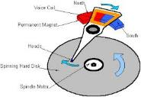




I/O and Storage Layers
Application / Service
High Level I/O
Streams (buffered I/O)
Low Level I/O
File Descriptors
Syscall
open(), read(), write(), close(), …
Open File Descriptions
File System
Files/Directories/Indexes
I/O Driver
Commands and Data Transfers
Disks, Flash, Controllers, DMA

Slide 29
C High-Level File API – Streams
Operates on “streams” – unformatted sequences of bytes (wither text or binary data), with a position:
Open stream represented by pointer to a FILE data structure
Error reported by returning a NULL pointer
#include <stdio.h>
FILE *fopen( const char *filename, const char *mode );
int fclose( FILE *fp );
Mode Text | Binary | Descriptions
r | rb | Open existing file for reading
w | wb | Open for writing; created if does not exist
a | ab | Open for appending; created if does not exist
r+ | rb+ | Open existing file for reading & writing.
w+ | wb+ | Open for reading & writing; truncated to zero if exists, create otherwise
a+ | ab+ | Open for reading & writing. Created if does not exist. Read from beginning, write as append

Slide 30
C API Standard Streams – stdio.h
Three predefined streams are opened implicitly when the program is executed.
FILE *stdin – normal source of input, can be redirected
FILE *stdout – normal source of output, can too
FILE *stderr – diagnostics and errors
STDIN / STDOUT enable composition in Unix
All can be redirected
cat hello.txt | grep “World!”
cat’s stdout goes to grep’s stdin

Slide 31
C High-Level File API
// character oriented
int fputc( int c, FILE *fp ); // rtn c or EOF on err
int fputs( const char *s, FILE *fp ); // rtn > 0 or EOF
int fgetc( FILE * fp );
char *fgets( char *buf, int n, FILE *fp );
// block oriented
size_t fread(void *ptr, size_t size_of_elements,
size_t number_of_elements, FILE *a_file);
size_t fwrite(const void *ptr, size_t size_of_elements,
size_t number_of_elements, FILE *a_file);
// formatted
int fprintf(FILE *restrict stream, const char *restrict format, ...);
int fscanf(FILE *restrict stream, const char *restrict format, ... );

Slide 32
C Streams: Char-by-Char I/O
int main(void) {
FILE* input = fopen(“input.txt”, “r”);
FILE* output = fopen(“output.txt”, “w”);
int c;
c = fgetc(input);
while (c != EOF) {
fputc(output, c);
c = fgetc(input);
}
fclose(input);
fclose(output);
}

Slide 33
C High-Level File API
// character oriented
int fputc( int c, FILE *fp ); // rtn c or EOF on err
int fputs( const char *s, FILE *fp ); // rtn > 0 or EOF
int fgetc( FILE * fp );
char *fgets( char *buf, int n, FILE *fp );
// block oriented
size_t fread(void *ptr, size_t size_of_elements,
size_t number_of_elements, FILE *a_file);
size_t fwrite(const void *ptr, size_t size_of_elements,
size_t number_of_elements, FILE *a_file);
// formatted
int fprintf(FILE *restrict stream, const char *restrict format, ...);
int fscanf(FILE *restrict stream, const char *restrict format, ... );

Slide 34
C Streams: Block-by-Block I/O
#define BUFFER_SIZE 1024
int main(void) {
FILE* input = fopen("input.txt", "r");
FILE* output = fopen("output.txt", "w");
char buffer[BUFFER_SIZE];
size_t length;
length = fread(buffer, BUFFER_SIZE, sizeof(char), input);
while (length > 0) {
fwrite(buffer, length, sizeof(char), output);
length = fread(buffer, BUFFER_SIZE, sizeof(char), input);
}
fclose(input);
fclose(output);
}

Slide 35
Aside: Check your Errors!
Systems programmers should always be paranoid!
Otherwise you get intermittently buggy code
We should really be writing things like:
FILE* input = fopen(“input.txt”, “r”);
if (input == NULL) {
// Prints our string and error msg.
perror(“Failed to open input file”)
}
Be thorough about checking return values!
Want failures to be systematically caught and dealt with
I may be a bit loose with error checking for examples in class (to keep short)
Do as I say, not as I show in class!

Slide 36
C High-Level File API: Positioning The Pointer
int fseek(FILE *stream, long int offset, int whence);
long int ftell (FILE *stream)
void rewind (FILE *stream)
For fseek(), the offset is interpreted based on the whence argument (constants in stdio.h):
SEEK_SET: Then offset interpreted from beginning (position 0)
SEEK_END: Then offset interpreted backwards from end of file
SEEK_CUR: Then offset interpreted from current position
Overall preserves high-level abstraction of a uniform stream of objects
offset (SEEK_SET)
offset (SEEK_END)
whence
offset (SEEK_CUR)

Slide 37
I/O and Storage Layers
Application / Service
High Level I/O
Streams (buffered I/O)
Low Level I/O
File Descriptors
Syscall
open(), read(), write(), close(), …
Open File Descriptions
File System
Files/Directories/Indexes
I/O Driver
Commands and Data Transfers
Disks, Flash, Controllers, DMA

Slide 38
Low-Level File I/O: The RAW system-call interface
#include <fcntl.h>
#include <unistd.h>
#include <sys/types.h>
int open (const char *filename, int flags [, mode_t mode])
int creat (const char *filename, mode_t mode)
int close (int filedes)
Bit vector of:
Access modes (Rd, Wr, …)
Open Flags (Create, …)
Operating modes (Appends, …)
Bit vector of Permission Bits:
User|Group|Other X R|W|X
Integer return from open() is a file descriptor
Error indicated by return < 0: the global errno variable set with error (see man pages)
Operations on file descriptors:
Open system call created an open file description entry in system-wide table of open files
Open file description object in the kernel represents an instance of an open file
Why give user an integer instead of a pointer to the file description in kernel?

Slide 39
C Low-Level (pre-opened) Standard Descriptors
#include <unistd.h>
STDIN_FILENO - macro has value 0
STDOUT_FILENO - macro has value 1
STDERR_FILENO - macro has value 2
// Get file descriptor inside FILE *
int fileno (FILE *stream)
// Make FILE * from descriptor
FILE * fdopen (int filedes, const char *opentype)

Slide 40
Low-Level File API
Read data from open file using file descriptor: ssize_t read (int filedes, void *buffer, size_t maxsize)
Reads up to maxsize bytes – might actually read less!
returns bytes read, 0 => EOF, -1 => error
Write data to open file using file descriptor ssize_t write (int filedes, const void *buffer, size_t size)
returns number of bytes written
Reposition file offset within kernel (this is independent of any position held by high-level FILE descriptor for this file! off_t lseek (int filedes, off_t offset, int whence)

Slide 41
Example: lowio.c
int main() {
char buf[1000];
int fd = open("lowio.c", O_RDONLY, S_IRUSR | S_IWUSR);
ssize_t rd = read(fd, buf, sizeof(buf));
int err = close(fd);
ssize_t wr = write(STDOUT_FILENO, buf, rd);
}
How many bytes does this program read?

Slide 42
POSIX I/O: Design Patterns
Open before use
Access control check, setup happens here
Byte-oriented
Least common denominator
OS responsible for hiding the fact that real devices may not work this way (e.g. hard drive stores data in blocks)
Explicit close

Slide 43
POSIX I/O: Kernel Buffering
Reads are buffered inside kernel
Part of making everything byte-oriented
Process is blocked while waiting for device
Let other processes run while gathering result
Writes are buffered inside kernel
Complete in background (more later on)
Return to user when data is “handed off” to kernel
This buffering is part of global buffer management and caching for block devices (such as disks)
Items typically cached in quanta of disk block sizes
We will have many interesting things to say about this buffering when we dive into the kernel

Slide 44
Low-Level I/O: Other Operations
Operations specific to terminals, devices, networking, …
e.g., ioctl
Duplicating descriptors
int dup2(int old, int new);
int dup(int old);
Pipes – channel
int pipe(int pipefd[2]);
Writes to pipefd[1] can be read from pipefd[0]
File Locking
Memory-Mapping Files
Asynchronous I/O

Slide 45
High-Level vs. Low-Level File API
High-Level Operation:
Low-Level Operation:
size_t fread(…) {
Do some work like a normal fn…
asm code … syscall # into %eax
put args into registers %ebx, …
special trap instruction
ssize_t read(…) {
asm code … syscall # into %eax
put args into registers %ebx, …
special trap instruction
Kernel:
Kernel:
get args from regs
dispatch to system func
Do the work to read from the file
Store return value in %eax
get args from regs
dispatch to system func
Do the work to read from the file
Store return value in %eax
get return values from regs
Do some more work like a normal fn…
};
get return values from regs
};

Slide 46
High-Level vs. Low-Level File API
Streams are buffered in user memory: printf("Beginning of line ");
sleep(10); // sleep for 10 seconds
printf("and end of line\n");
Prints out everything at once
Operations on file descriptors are visible immediately
write(STDOUT_FILENO, "Beginning of line ", 18);
sleep(10);
write("and end of line \n", 16);
Outputs "Beginning of line" 10 seconds earlier than “and end of line”

Slide 47
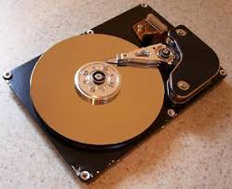
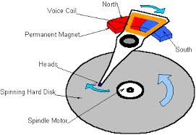
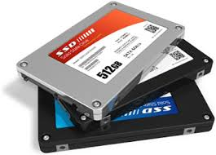

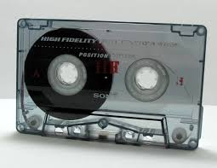
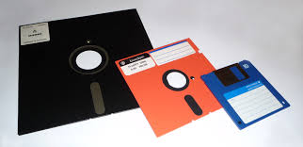
What’s below the surface ??
Application / Service
High Level I/O
streams
Low Level I/O
handles
Syscall
registers
File System
descriptions
I/O Driver
Commands and Data Transfers
Disks, Flash, Controllers, DMA

Slide 48
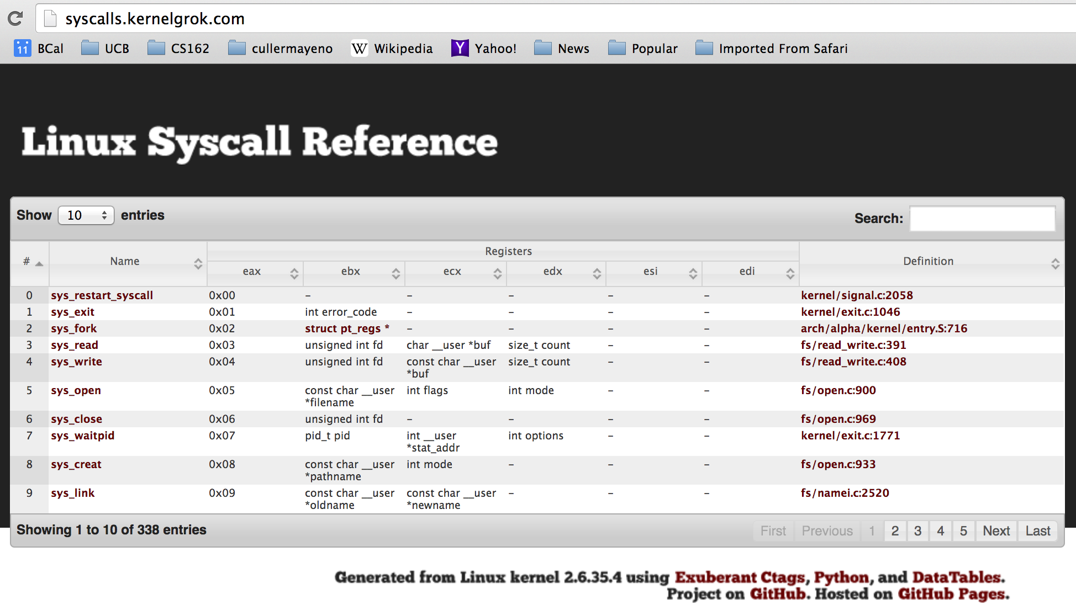
Recall: SYSCALL
Low level lib parameters are set up in registers and syscall instruction is issued
A type of synchronous exception that enters well-defined entry points into kernel

Slide 49
What’s below the surface ??
File descriptor number
- an int
Application / Service
High Level I/O
streams
Low Level I/O
handles
Syscall
registers
File System
descriptions
File description
a struct with all the info about the files
I/O Driver
Commands and Data Transfers
Disks, Flash, Controllers, DMA

Slide 50
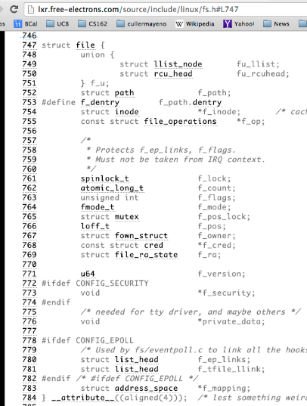
What’s in an Open File Description?
Inside Kernel!
For our purposes, the two most important things are:
Where to find the file data on disk
The current position within the file

Slide 51
File System: from syscall to driver
In fs/read_write.c
ssize_t vfs_read(struct file *file, char __user *buf, size_t count, loff_t *pos)
{
ssize_t ret;
if (!(file->f_mode & FMODE_READ)) return -EBADF;
if (!file->f_op || (!file->f_op->read && !file->f_op->aio_read))
return -EINVAL;
if (unlikely(!access_ok(VERIFY_WRITE, buf, count))) return -EFAULT;
ret = rw_verify_area(READ, file, pos, count);
if (ret >= 0) {
count = ret;
if (file->f_op->read)
ret = file->f_op->read(file, buf, count, pos);
else
ret = do_sync_read(file, buf, count, pos);
if (ret > 0) {
fsnotify_access(file->f_path.dentry);
add_rchar(current, ret);
}
inc_syscr(current);
}
return ret;
}
Read up to “count” bytes from “file” starting from “pos” into “buf”.
Return error or number of bytes read.

Slide 52
File System: from syscall to driver
In fs/read_write.c
ssize_t vfs_read(struct file *file, char __user *buf, size_t count, loff_t *pos)
{
ssize_t ret;
if (!(file->f_mode & FMODE_READ)) return -EBADF;
if (!file->f_op || (!file->f_op->read && !file->f_op->aio_read))
return -EINVAL;
if (unlikely(!access_ok(VERIFY_WRITE, buf, count))) return -EFAULT;
ret = rw_verify_area(READ, file, pos, count);
if (ret >= 0) {
count = ret;
if (file->f_op->read)
ret = file->f_op->read(file, buf, count, pos);
else
ret = do_sync_read(file, buf, count, pos);
if (ret > 0) {
fsnotify_access(file->f_path.dentry);
add_rchar(current, ret);
}
inc_syscr(current);
}
return ret;
}
Make sure we are allowed to read this file

Slide 53
File System: from syscall to driver
In fs/read_write.c
ssize_t vfs_read(struct file *file, char __user *buf, size_t count, loff_t *pos)
{
ssize_t ret;
if (!(file->f_mode & FMODE_READ)) return -EBADF;
if (!file->f_op || (!file->f_op->read && !file->f_op->aio_read))
return -EINVAL;
if (unlikely(!access_ok(VERIFY_WRITE, buf, count))) return -EFAULT;
ret = rw_verify_area(READ, file, pos, count);
if (ret >= 0) {
count = ret;
if (file->f_op->read)
ret = file->f_op->read(file, buf, count, pos);
else
ret = do_sync_read(file, buf, count, pos);
if (ret > 0) {
fsnotify_access(file->f_path.dentry);
add_rchar(current, ret);
}
inc_syscr(current);
}
return ret;
}
Check if file has read methods

Slide 54
File System: from syscall to driver
In fs/read_write.c
ssize_t vfs_read(struct file *file, char __user *buf, size_t count, loff_t *pos)
{
ssize_t ret;
if (!(file->f_mode & FMODE_READ)) return -EBADF;
if (!file->f_op || (!file->f_op->read && !file->f_op->aio_read))
return -EINVAL;
if (unlikely(!access_ok(VERIFY_WRITE, buf, count))) return -EFAULT;
ret = rw_verify_area(READ, file, pos, count);
if (ret >= 0) {
count = ret;
if (file->f_op->read)
ret = file->f_op->read(file, buf, count, pos);
else
ret = do_sync_read(file, buf, count, pos);
if (ret > 0) {
fsnotify_access(file->f_path.dentry);
add_rchar(current, ret);
}
inc_syscr(current);
}
return ret;
}
Check whether we can write to buf (e.g., buf is in the user space range)
unlikely(): hint to branch prediction this condition is unlikely

Slide 55
File System: from syscall to driver
In fs/read_write.c
ssize_t vfs_read(struct file *file, char __user *buf, size_t count, loff_t *pos)
{
ssize_t ret;
if (!(file->f_mode & FMODE_READ)) return -EBADF;
if (!file->f_op || (!file->f_op->read && !file->f_op->aio_read))
return -EINVAL;
if (unlikely(!access_ok(VERIFY_WRITE, buf, count))) return -EFAULT;
ret = rw_verify_area(READ, file, pos, count);
if (ret >= 0) {
count = ret;
if (file->f_op->read)
ret = file->f_op->read(file, buf, count, pos);
else
ret = do_sync_read(file, buf, count, pos);
if (ret > 0) {
fsnotify_access(file->f_path.dentry);
add_rchar(current, ret);
}
inc_syscr(current);
}
return ret;
}
Check whether we read from a valid range in the file.

Slide 56
File System: from syscall to driver
In fs/read_write.c
ssize_t vfs_read(struct file *file, char __user *buf, size_t count, loff_t *pos)
{
ssize_t ret;
if (!(file->f_mode & FMODE_READ)) return -EBADF;
if (!file->f_op || (!file->f_op->read && !file->f_op->aio_read))
return -EINVAL;
if (unlikely(!access_ok(VERIFY_WRITE, buf, count))) return -EFAULT;
ret = rw_verify_area(READ, file, pos, count);
if (ret >= 0) {
count = ret;
if (file->f_op->read)
ret = file->f_op->read(file, buf, count, pos);
else
ret = do_sync_read(file, buf, count, pos);
if (ret > 0) {
fsnotify_access(file->f_path.dentry);
add_rchar(current, ret);
}
inc_syscr(current);
}
return ret;
}
If driver provide a read function (f_op->read) use it; otherwise use do_sync_read()

Slide 57
File System: from syscall to driver
In fs/read_write.c
ssize_t vfs_read(struct file *file, char __user *buf, size_t count, loff_t *pos)
{
ssize_t ret;
if (!(file->f_mode & FMODE_READ)) return -EBADF;
if (!file->f_op || (!file->f_op->read && !file->f_op->aio_read))
return -EINVAL;
if (unlikely(!access_ok(VERIFY_WRITE, buf, count))) return -EFAULT;
ret = rw_verify_area(READ, file, pos, count);
if (ret >= 0) {
count = ret;
if (file->f_op->read)
ret = file->f_op->read(file, buf, count, pos);
else
ret = do_sync_read(file, buf, count, pos);
if (ret > 0) {
fsnotify_access(file->f_path.dentry);
add_rchar(current, ret);
}
inc_syscr(current);
}
return ret;
}
Notify the parent of this file that the file was read (see http://www.fieldses.org/~bfields/kernel/vfs.txt)

Slide 58
File System: from syscall to driver
In fs/read_write.c
ssize_t vfs_read(struct file *file, char __user *buf, size_t count, loff_t *pos)
{
ssize_t ret;
if (!(file->f_mode & FMODE_READ)) return -EBADF;
if (!file->f_op || (!file->f_op->read && !file->f_op->aio_read))
return -EINVAL;
if (unlikely(!access_ok(VERIFY_WRITE, buf, count))) return -EFAULT;
ret = rw_verify_area(READ, file, pos, count);
if (ret >= 0) {
count = ret;
if (file->f_op->read)
ret = file->f_op->read(file, buf, count, pos);
else
ret = do_sync_read(file, buf, count, pos);
if (ret > 0) {
fsnotify_access(file->f_path.dentry);
add_rchar(current, ret);
}
inc_syscr(current);
}
return ret;
}
Update the number of bytes read by “current” task (for scheduling purposes)

Slide 59
File System: from syscall to driver
In fs/read_write.c
ssize_t vfs_read(struct file *file, char __user *buf, size_t count, loff_t *pos)
{
ssize_t ret;
if (!(file->f_mode & FMODE_READ)) return -EBADF;
if (!file->f_op || (!file->f_op->read && !file->f_op->aio_read))
return -EINVAL;
if (unlikely(!access_ok(VERIFY_WRITE, buf, count))) return -EFAULT;
ret = rw_verify_area(READ, file, pos, count);
if (ret >= 0) {
count = ret;
if (file->f_op->read)
ret = file->f_op->read(file, buf, count, pos);
else
ret = do_sync_read(file, buf, count, pos);
if (ret > 0) {
fsnotify_access(file->f_path.dentry);
add_rchar(current, ret);
}
inc_syscr(current);
}
return ret;
}
Update the number of read syscalls by “current” task (for scheduling purposes)

Slide 60
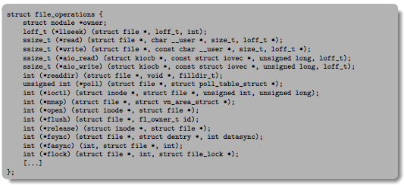
Lower Level Driver
Associated with particular hardware device
Registers / Unregisters itself with the kernel
Handler functions for each of the file operations

Slide 61
Device Drivers
Device Driver: Device-specific code in the kernel that interacts directly with the device hardware
Supports a standard, internal interface
Same kernel I/O system can interact easily with different device drivers
Special device-specific configuration supported with the ioctl() system call
Device Drivers typically divided into two pieces:
Top half: accessed in call path from system calls
implements a set of standard, cross-device calls like open(), close(), read(), write(), ioctl(), strategy()
This is the kernel’s interface to the device driver
Top half will start I/O to device, may put thread to sleep until finished
Bottom half: run as interrupt routine
Gets input or transfers next block of output
May wake sleeping threads if I/O now complete

Slide 62
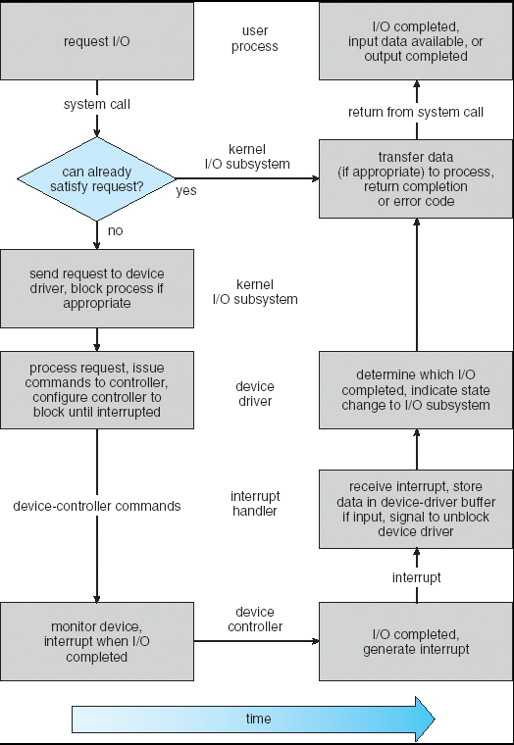
Life Cycle of An I/O Request
User
Program
Kernel I/O
Subsystem
Device Driver
Top Half
Device Driver
Bottom Half
Device
Hardware

Slide 63
Communication between processes
Can we view files as communication channels?
Producer and Consumer of a file may be distinct processes
May be separated in time (or not)
However, what if data written once and consumed once?
Don’t we want something more like a queue?
Can still look like File I/O!
write(wfd, wbuf, wlen);
n = read(rfd,rbuf,rmax);

Slide 64
Communication Across the world looks like file IO!
write(wfd, wbuf, wlen);
n = read(rfd,rbuf,rmax);
Connected queues over the Internet
But what’s the analog of open?
What is the namespace?
How are they connected in time?

Slide 65
Request Response Protocol
Client (issues requests)
Server (performs operations)
write(rqfd, rqbuf, buflen);
requests
n = read(rfd,rbuf,rmax);
wait
service request
write(wfd, respbuf, len);
responses
n = read(resfd,resbuf,resmax);

Slide 66
Request Response Protocol: Across Network
Client (issues requests)
Server (performs operations)
write(rqfd, rqbuf, buflen);
requests
n = read(rfd,rbuf,rmax);
wait
service request
write(wfd, respbuf, len);
responses
n = read(resfd,resbuf,resmax);

Slide 67
The Socket Abstraction: Endpoint for Communication
Key Idea: Communication across the world looks like File I/O
Sockets: Endpoint for Communication
Queues to temporarily hold results
Connection: Two Sockets Connected Over the network ⇒ IPC over network!
How to open()?
What is the namespace?
How are they connected in time?
write(wfd, wbuf, wlen);
Process
Socket
Socket
Process
n = read(rfd, rbuf, rmax);

Slide 68
Sockets: More Details
Socket: An abstraction for one endpoint of a network connection
Another mechanism for inter-process communication
Most operating systems (Linux, Mac OS X, Windows) provide this, even if they don’t copy rest of UNIX I/O
Standardized by POSIX
First introduced in 4.2 BSD (Berkeley Standard Distribution) Unix
This release had some huge benefits (and excitement from potential users)
Runners waiting at release time to get release on tape and take to businesses
Same abstraction for any kind of network
Local (within same machine)
The Internet (TCP/IP, UDP/IP)
Things “no one” uses anymore (OSI, Appletalk, IPX, …)

Slide 69
Sockets: More Details
Looks just like a file with a file descriptor
Corresponds to a network connection (two queues)
write adds to output queue (queue of data destined for other side)
read removes from it input queue (queue of data destined for this side)
Some operations do not work, e.g. lseek
How can we use sockets to support real applications?
A bidirectional byte stream isn’t useful on its own…
May need messaging facility to partition stream into chunks
May need RPC facility to translate one environment to another and provide the abstraction of a function call over the network

Slide 70


Simple Example: Echo Server
“hello, world”
“hello, world”
Client
Web Server

Slide 71


Simple Example: Echo Server
Client (issues requests)
Server (services requests)
fgets(sndbuf,bufsize,stdin);
write(sockfd,sndbuf,strlen(sndbuf)+1);
n = read(sockfd,reqbuf,…);
wait
n = read(sockfd,rcvbuf, …);
Server
Socket
print
Client
Socket
wait
write(sockfd,reqbuf,…);
print

Slide 72
Echo client-server example
void client(int sockfd) {
int n;
char sndbuf[MAXIN]; char rcvbuf[MAXOUT];
while (1) {
fgets(sndbuf,MAXIN,stdin); /* prompt */
write(sockfd, sndbuf, strlen(sndbuf)+1); /* send (including null terminator) */
memset(rcvbuf,0,MAXOUT); /* clear */
n=read(sockfd, rcvbuf, MAXOUT); /* receive */
write(STDOUT_FILENO, rcvbuf, n); /* echo */
}
void server(int consockfd) {
char reqbuf[MAXREQ];
int n;
while (1) {
memset(reqbuf,0, MAXREQ);
len = read(consockfd,reqbuf,MAXREQ); /* Recv */
if (n <= 0) return;
write(STDOUT_FILENO, reqbuf, n);
write(consockfd, reqbuf, n); /* echo*/
}
}

Slide 73
What Assumptions are we Making?
Reliable
Write to a file => Read it back. Nothing is lost.
Write to a (TCP) socket => Read from the other side, same.
In order (sequential stream)
Write X then write Y => read gets X then read gets Y
When ready?
File read gets whatever is there at the time
Actually need to loop and read until we receive the terminator (‘\0’)
Assumes writing already took place
Blocks if nothing has arrived yet

Slide 74
Socket Creation
File systems provide a collection of permanent objects in a structured name space:
Processes open, read/write/close them
Files exist independently of processes
Easy to name what file to open()
Pipes: one-way communication between processes on same (physical) machine
Single queue
Created transiently by a call to pipe()
Passed from parent to children (descriptors inherited from parent process)
Sockets: two-way communication between processes on same or different machine
Two queues (one in each direction)
Processes can be on separate machines: no common ancestor
How do we name the objects we are opening?
How do these completely independent programs know that the other wants to “talk” to them?

Slide 75
Namespaces for Communication over IP
Hostname
www.eecs.berkeley.edu
IP address
128.32.244.172 (IPv4, 32-bit Integer)
2607:f140:0:81::f (IPv6, 128-bit Integer)
Port Number
0-1023 are “well known” or “system” ports
Superuser privileges to bind to one
1024 – 49151 are “registered” ports (registry)
Assigned by IANA for specific services
49152–65535 (2¹⁵+2¹⁴ to 2¹⁶−1) are “dynamic” or “private”
Automatically allocated as “ephemeral ports”

Slide 76
Connection Setup over TCP/IP
Client Side
Server Side
Server
Socket
Server Listening:
Server IP addr
well-known port,
Protocol (TCP/IP)
Connection request:
Client IP addr
Client Port
Protocol (TCP/IP)
Request Connection
new
socket
socket
socket
connection
Special kind of socket: server socket
Has file descriptor
Can’t read or write
Two operations:
listen(): Start allowing clients to connect
accept(): Create a new socket for a particular client

Slide 77
Connection Setup over TCP/IP
Client Side
Server Side
Server
Socket
Server Listening:
Server IP addr
well-known port,
Protocol (TCP/IP)
Connection request:
Client IP addr
Client Port
Protocol (TCP/IP)
Request Connection
new
socket
socket
socket
connection
5-Tuple identifies each connection:
Source IP Address
Destination IP Address
Source Port Number
Destination Port Number
Protocol (always TCP here)
Often, Client Port “randomly” assigned
Done by OS during client socket setup
Server Port often “well known”
80 (web), 443 (secure web), 25 (sendmail), etc
Well-known ports from 0—1023

Slide 78
Conclusion (I)
System Call Interface is “narrow waist” between user programs and kernel
Streaming IO: modeled as a stream of bytes
Most streaming I/O functions start with “f” (like “fread”)
Data buffered automatically by C-library functions
Low-level I/O:
File descriptors are integers
Low-level I/O supported directly at system call level
STDIN / STDOUT enable composition in Unix
Use of pipe symbols connects STDOUT and STDIN
find | grep | wc …

Slide 79
Conclusion (II)
Device Driver: Device-specific code in the kernel that interacts directly with the device hardware
Supports a standard, internal interface
Same kernel I/O system can interact easily with different device drivers
File abstraction works for inter-processes communication (local or Internet)
Socket: an abstraction of a network I/O queue
Mechanism for inter-process communication

